Slide 1


Churn Prediction and Retention Strategies for a Telecom Company
This presentation explores a data-driven approach to predict customer churn and implement effective retention strategies for a telecom company. We will delve into the methodology used for building a churn prediction model and examine its impact on business outcomes.
by Ayush Mahandule

Slide 2

Introduction
1
Customer Churn
Customer churn is a significant challenge for telecom companies. It represents the loss of valuable subscribers, resulting in revenue decline and decreased market share.
2
Data-Driven Insights
By leveraging data analytics and machine learning techniques, we can gain valuable insights into customer behavior and identify patterns that predict churn.
3
Proactive Retention
This enables us to develop proactive retention strategies, such as targeted offers and personalized communications, to retain at-risk customers and improve customer loyalty.

Slide 3
Problem Statement
High Churn Rate
Revenue Loss
Proactive Solution
The telecom company is experiencing a high churn rate, indicating a substantial number of customers discontinuing their services.
This leads to significant financial losses and negatively impacts the company's long-term growth and profitability.
A proactive solution is needed to identify and address the factors contributing to churn, thereby preventing customer attrition.

Slide 4
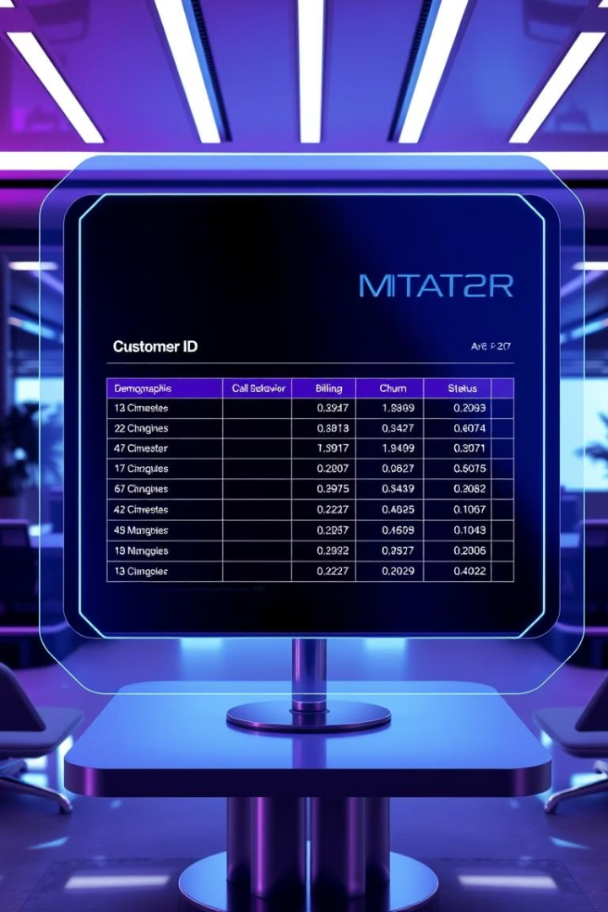
Data Overview
1
Customer Demographics
The dataset includes customer demographic information, such as age, gender, location, and income level.
2
Call Behavior
Call data includes details about call duration, frequency, and patterns, providing insights into customer usage patterns.
3
Billing History
Billing data encompasses information on monthly charges, payment history, and contract details, reflecting customer spending habits.
4
Churn Definition
Customer churn is defined as the discontinuation of service within a specified timeframe, typically a month or a quarter.

Slide 5

Data Preprocessing
1
Missing Data
Missing values in the dataset are handled using appropriate imputation techniques, ensuring data completeness.
2
Feature Encoding
Categorical features, such as location and contract type, are encoded into numerical values for model training.
3
Data Scaling
Numerical features are scaled to a common range, preventing biases and enhancing model performance.
4
Train-Test Split
The data is split into training and testing sets, allowing for model training and evaluation on unseen data.

Slide 6

Algorithms Used
Decision Tree
A decision tree is a supervised learning algorithm that uses a tree-like structure to make predictions based on a series of decisions.
Random Forest
A random forest algorithm builds an ensemble of decision trees, averaging their predictions to improve accuracy and reduce overfitting.
XGBoost
XGBoost is a gradient boosting algorithm that iteratively builds decision trees, combining them to achieve high performance.

Slide 7
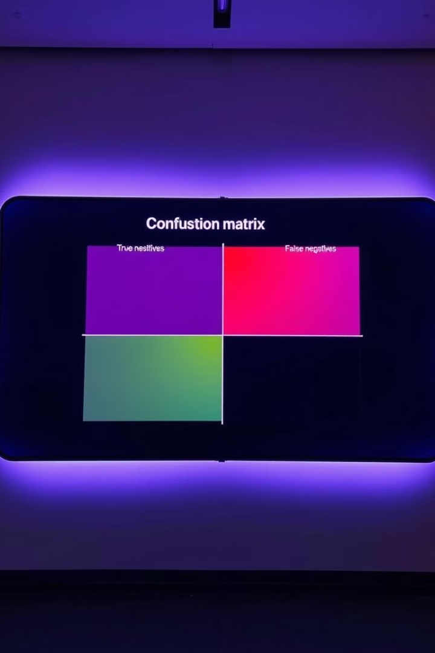
Model Evaluation Metrics
Accuracy
Proportion of correctly classified instances
Precision
Proportion of correctly predicted churn cases among all predicted churn cases
Recall
Proportion of correctly predicted churn cases among all actual churn cases
F1 Score
Harmonic mean of precision and recall, balancing the two metrics

Slide 8
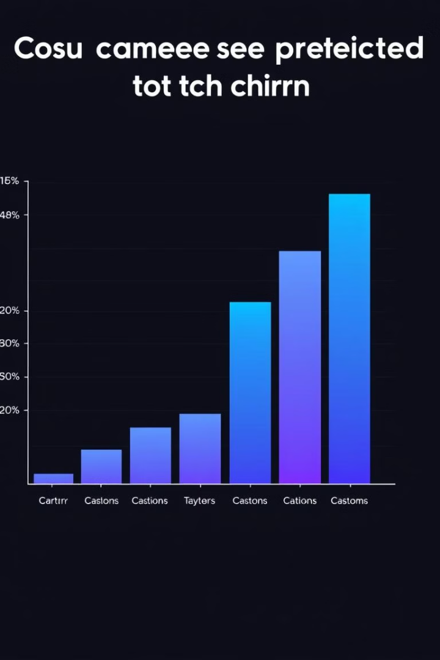



Churn Prediction Results
High-Risk Customers
The model identifies segments of customers with a high likelihood of churning, enabling targeted interventions.
Revenue Protection
By predicting churn, the company can proactively address at-risk customers and potentially retain their business.
Targeted Interventions
The model provides insights into the factors influencing churn, enabling the development of effective retention strategies.

